Slide 1
Analysis of Adult Census Data
Group 8:
Ananya Chowdhury
Gaurav Dhavale
Nikhil Salian
Vipul Andhare
Yanting Cao
Denghui Wang

Slide 2
Introduction
Target market - group of customers a business has decided to aim.
Clusters of consumers with similar needs that most businesses target their marketing efforts in order to sell their products and services.
Market segmentation including the following:
Geographic - Addresses, Location, Climate, Region
Demographic/socioeconomic segmentation - Gender, age, wage, career, education.
Psychographic - Attitudes, values, religion, and lifestyles
Behavioral segmentation - (occasions, degree of loyalty)
Product-related segmentation - (relationship to a product)
The prediction task is to determine whether a person makes over $50K a year.

Slide 3
Objective
Analyze the impact of diverse factors on annual income.
Predict whether a customer has income less than or more than 50k.
Identify the most probable factors for a persons income to be more than 50k.
Help companies in target marketing by planning better strategies for specific audience for the product they are marketing

Slide 4
Data Set
This data was extracted from the 1994 Census bureau database by Ronny Kohavi and Barry
A set of reasonably clean records was extracted using the following conditions Age > 16
Contains 32000 records 14 input parameters
1 Target variable(Income)

Slide 5
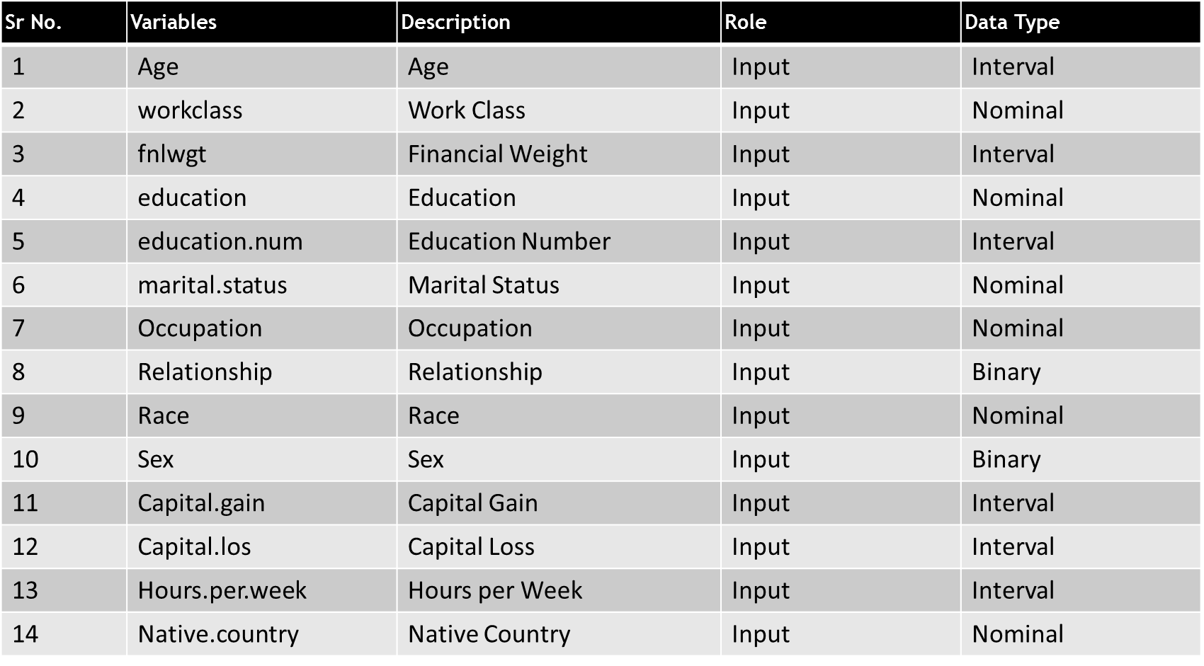
Input Variables

Slide 6
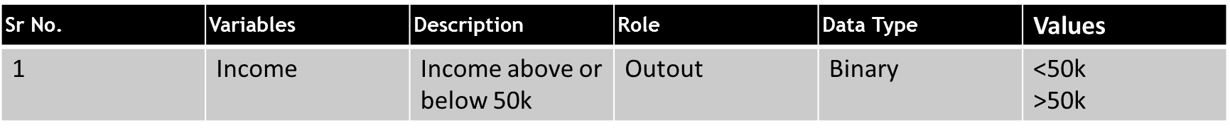
Output Variable
Income Variable contains data about annual salary ,it can be above 50k or below 50k
The percentage of sample above 50k is 24%
The percentage of sample below 50k is 76%

Slide 7
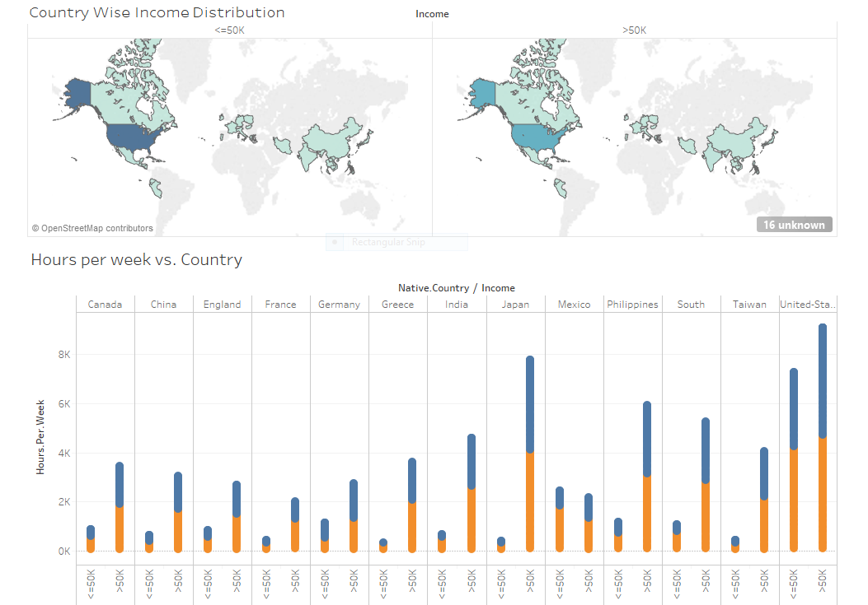
BUAN6356/MIS6356
Fall, 2016– Gregory G. MacDonald, PhD
(Lecture #1)

Slide 8
Insights
There are more number of people in USA having salary <=50k
If you work for more hours week you will definitely have salary >50k
Ratio of number people having salary <=50k to the number if people having salary >50k is minimum for Japan and maximum for USA.

Slide 9
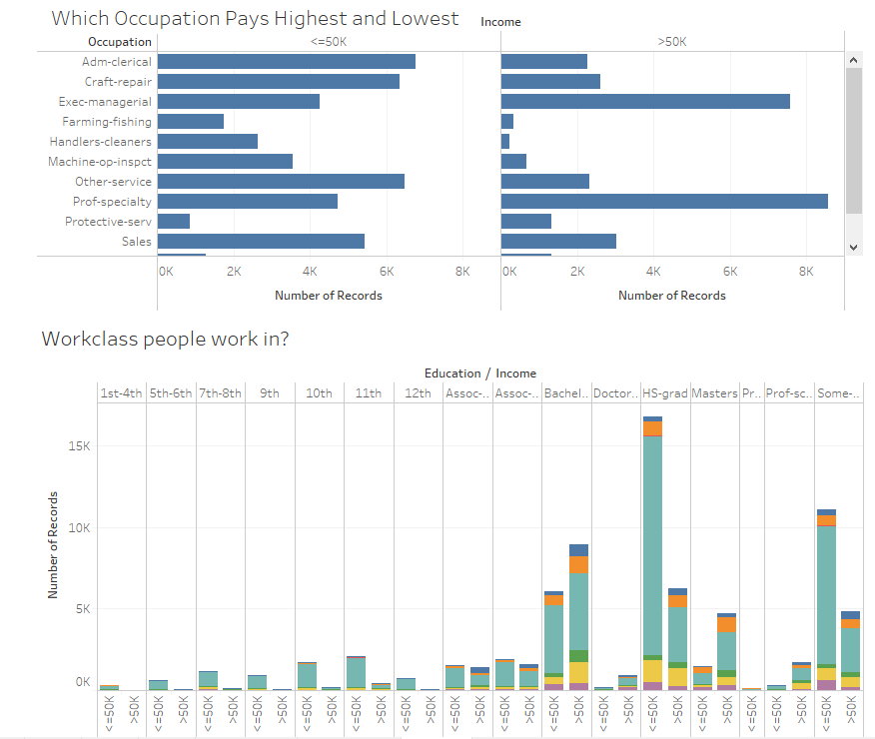

Slide 10
Insights
If you are an Executive-Managerial or Prof-specialty you re more probable to have salary >50k where as,
If a person have done bachelors, HS-grad or masters, he/she tends to have more income though there are more people who are HS-Graduate but still have income <=50k

Slide 11
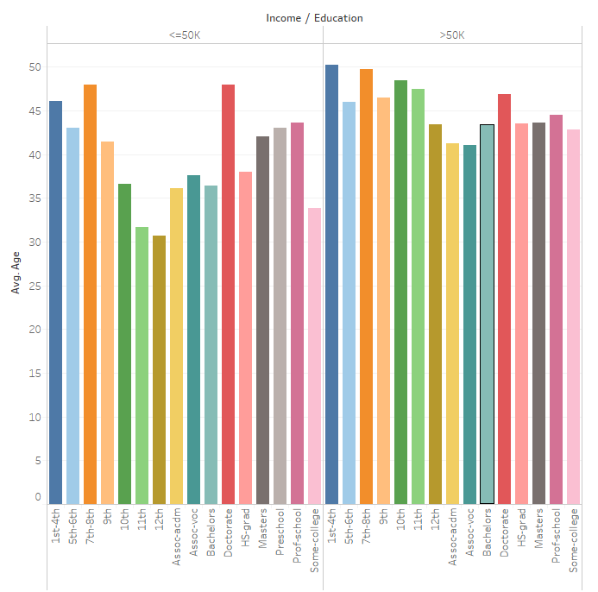
Avg. Age vs. Education vs. Income
Average age of people earning >50k is more
There is not single type of education which has more people having salary >50k

Slide 12
Data Preparation
Missing Data
Issue resolved using mice package.
Implemented in R using random forest method and 5 imputation.
Missing values reduced from 1297 to 0
Class imbalance
Issue resolved using smote package.
Dataset increased from 32k to 78k
Before SMOTE, Target variable value for >50k annual income = 24%, After SMOTE: 40%

Slide 13
Dirty Data cleanup
Data cleanup for education
Cleanup after smote on age, capital loss and gain

Slide 14
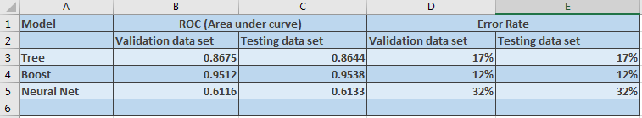
Data Filtering and Partitioning
Partitioning:
Train: 70 %
Validate: 15 %
Test: 15 %
Comparison of Different Models

Slide 15
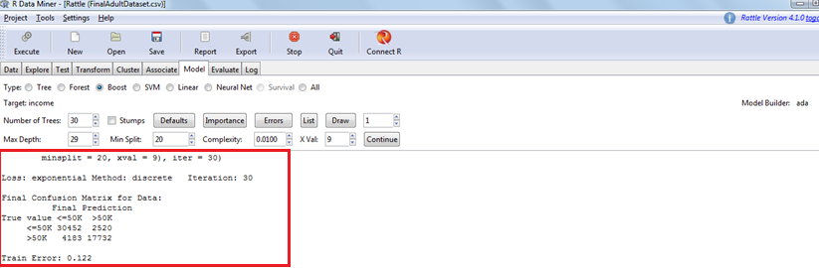
Boost model
Boosting algorithms consist of iteratively learning weak classifiers with respect to a distribution and adding them to a final strong classifier.

Slide 16
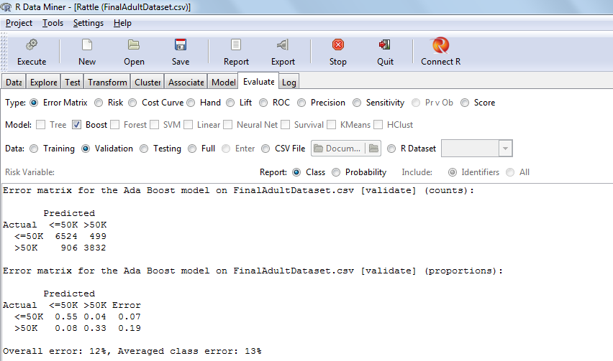
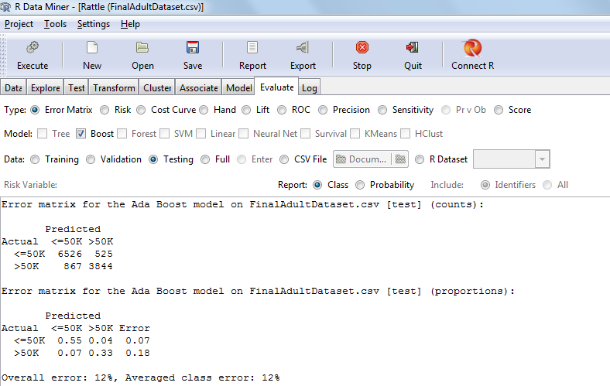
Validation Testing

Slide 17
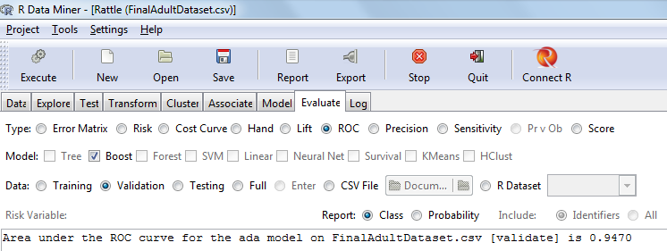
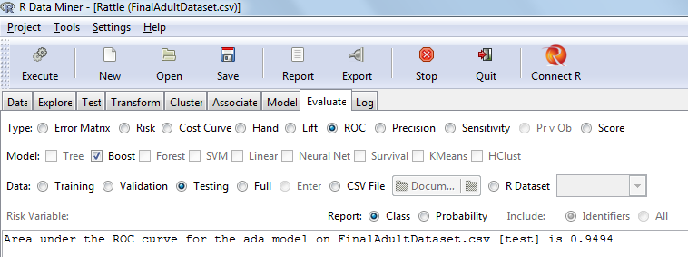
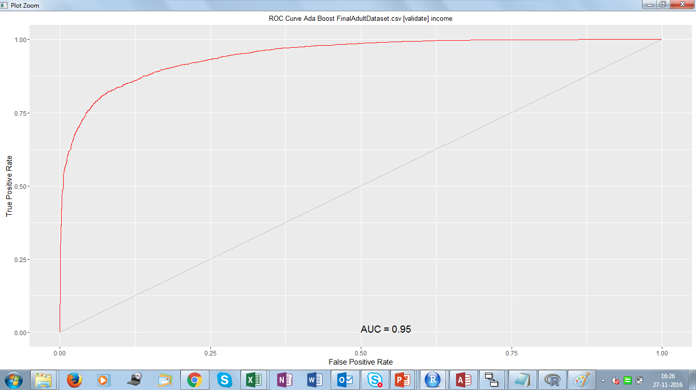
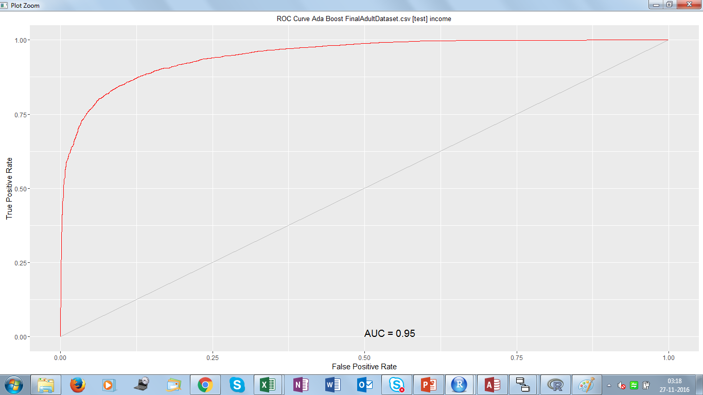
ROC for Boost Model
Validation Testing

Slide 18
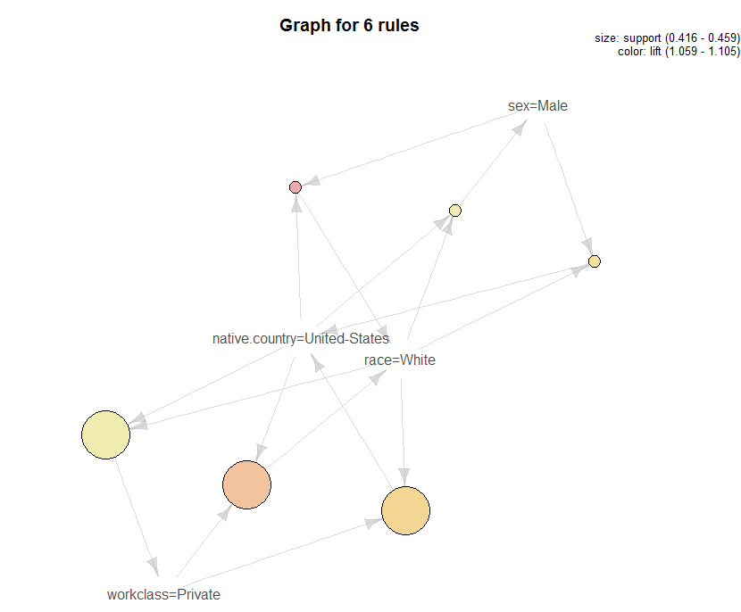
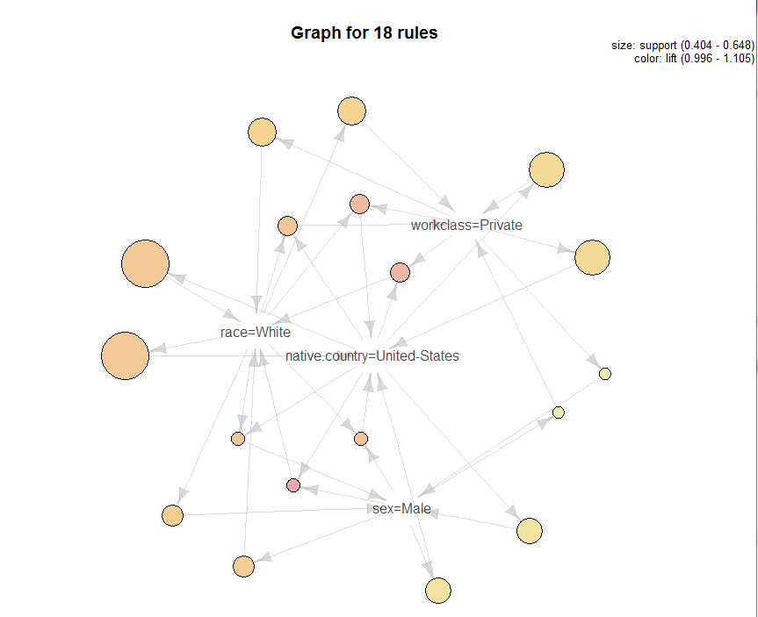
Association Analysis
2
High confidence rules from each frequent itemset
1
Frequent itemset generation
Support >= minsup 0.4

Slide 19
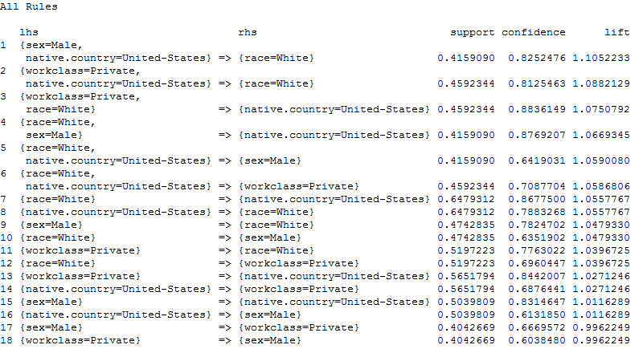
Association Rules
Observations
{white, united-states} -> {private}
{private, united-states} -> {white}
{private, white} -> {united-states}
{male, white} -> {united-states}
{white, united-states} -> {male}
{male, united-states} -> {white}
{White, United-states, Private}
{White, United-states ,Male}

Slide 20
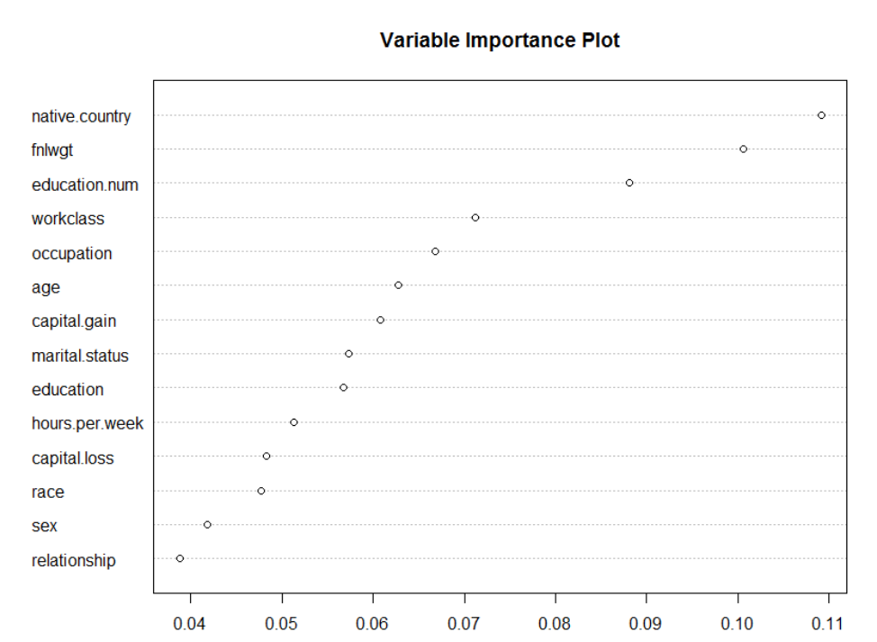
Variable Importance Evaluation
Target: Income
Top 5 factors:
Native.country
Fnlwgt
Education
Workclass
Occupation
Less important factors:
Sex
Relationship

Slide 21
Suggestion
Based on the association rules, we found that the the native country and workclass are strongly associated, and they are the main factors influence income. Also, the occupation, number of years of education and the age play an important role of influencing income.
For marketing, target the private workclass and the native country is united states will be profitable.

Slide 22
Reference
http://robotics.stanford.edu/~ronnyk/nbtree.pdf
https://www.kaggle.com/uciml/adult-census-income
http://scg.sdsu.edu/dataset-adult_r/
https://en.wikipedia.org/wiki/Target_market

Slide 23


